Slide 1
Network-Accelerator Co-Design for Dynamic Inference of Natural Language Processing
宋玉红
2020.07.26

Slide 2
Outline
Code processing
Problems need to be solved
TODO

Slide 3
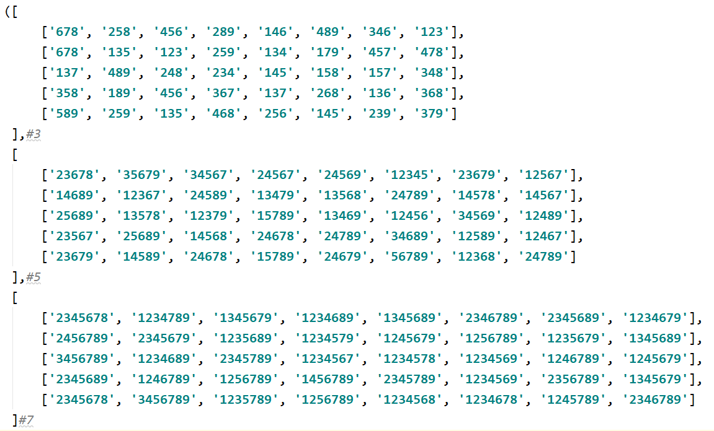
Code processing
Start from reinforcement learning
The input is three types pattern(pruning number = 3,5,7)
Pattern set is generated randomly
mask
pattern

Slide 4
Code processing
Pruning train
Input: mask_set
['678', '258', '456', '289', '146', '489', '346', '123'] #3
['23678', '35679', '34567', '24567', '24569', '12345', '23679', '12567'] #5
['2345678', '1234789', '1345679', '1234689', '1345689', '2346789', '2345689', '1234679'] #7
Training
Choose pattern using Euclidean distance based on weight block in every epoch
Generate sub-model based pattern pruning
Compute sub-loss in every batch
Use weighted loss to update model parameters
Result in a shared model cross every mask
Compute weighted accuracy
Pattern pruning on shared model
Compute sub-accuracy in every sub-model
Return weighted accuracy

Slide 5
Problems
How to decide the weight while computing weighted loss and weighted accuracy?
How to pre-choose pruning number to represent different energy?
Maybe need to do some test(more reasonable)
How to choose pattern from a big search space
Now random(OK)
……

Slide 6
TODO
Build performance model for time constraint
Test and modify the code
Do some comparable experiments
Baseline→pre-compression model(accuracy, time, energy, sparsity ratio)
Test different energy situations alone, no trade-off
Update shared model using just one mask, explore the influence on other masks.

